Slide 1
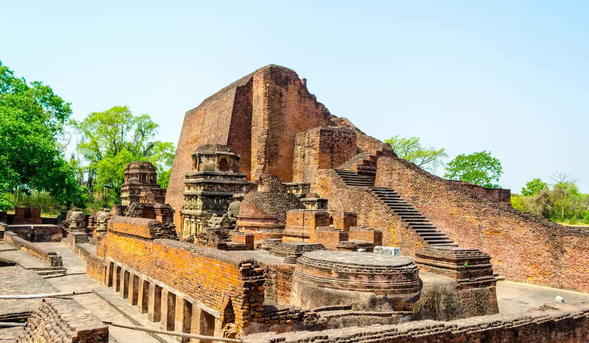
THE
NALANDA
UNIVERSITY

Slide 2
T I M E L I N E OF NALANDA UNIVERSITY
Golden Age of Learning, Thrives as a Buddhist university, attracting scholars like Hiuen Tsang and Yijing.
Nalanda is sacked, its monks killed, and its library destroyed.
10TH-12TH
CENTURY CE
20-21st Century
5th Century BCE-5th Century CE
5th to 9th Century CE
1193 CE
Originates as a Vedic learning center, formally established under the Gupta Empire.
Political unrest and declining patronage lead to a slow deterioration of the university's influence.
Archaeological efforts rediscover its ruins, and Nalanda is re-established as an international university in 2014.

Slide 3

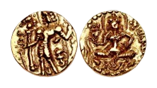

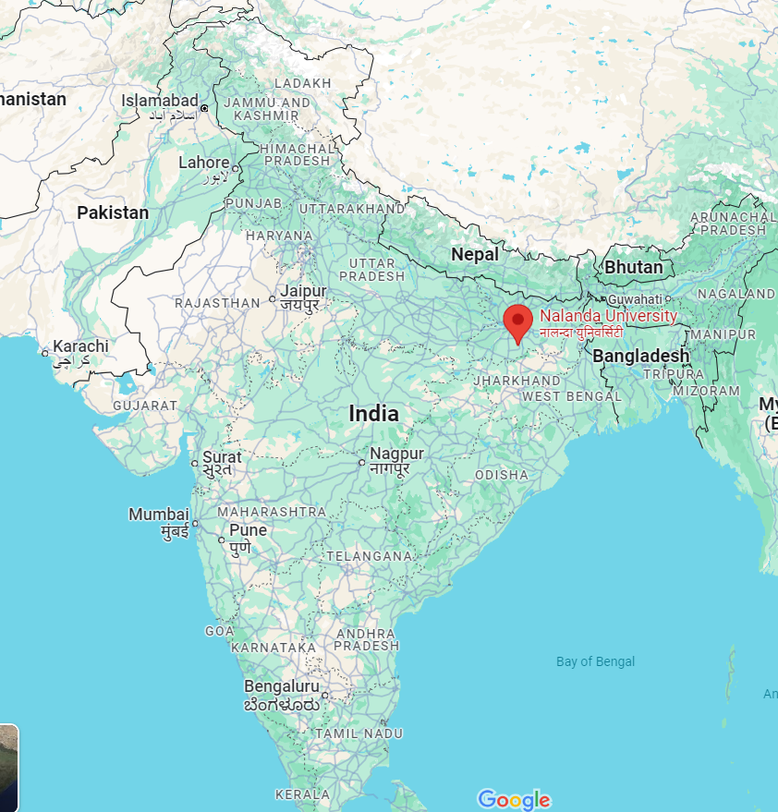


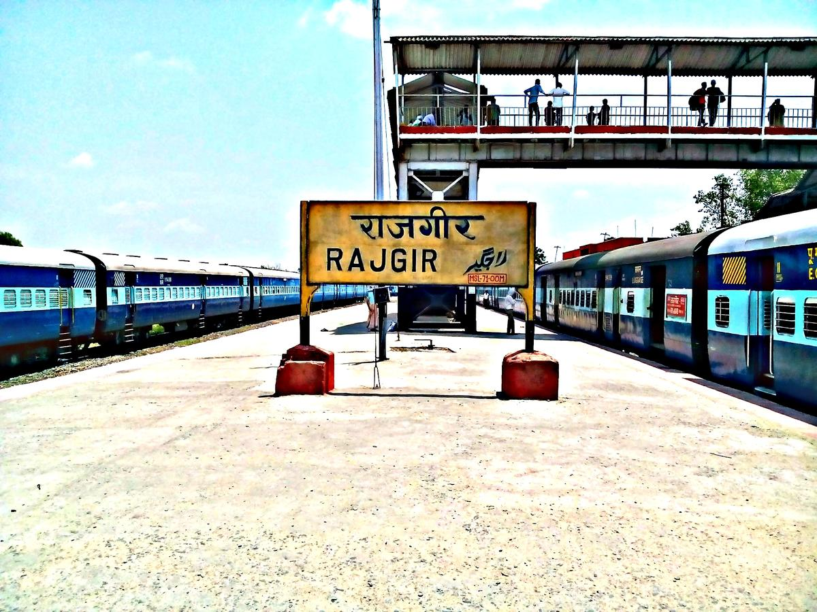

Historical Background
Nalanda University
When and by whom was Nalanda University founded?
FOUNDATION
Founded by the Gupta Emperor Kumaragupta I in 427 CE. It is located in the ancient kingdom of Magadha.
01
Where is Nalanda located?
Nalanda, an ancient Buddhist monastery and university in India, is located in the state of Bihar.
LOCATION
02
The Time when Nalanda flourished
TIME PERIOD
It flourished for 600 years till the 12th century. (Golden Age of Nalanda)
03
How can we reach the old Nalanda University?
HOW TO REACH
Rajgir is the nearest railhead, located about 12 km from Nalanda.
04

Slide 4
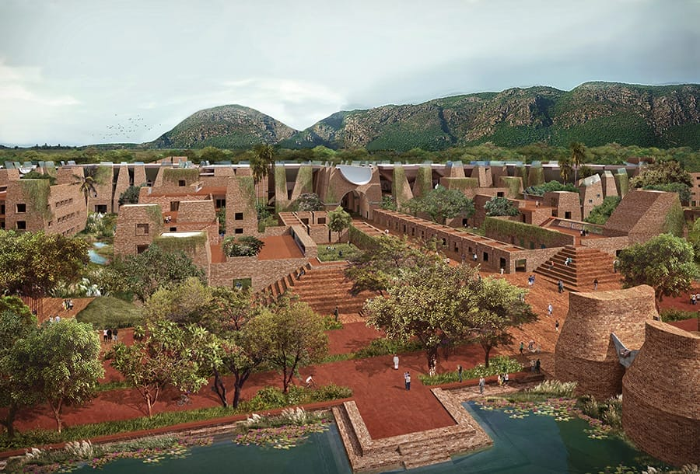
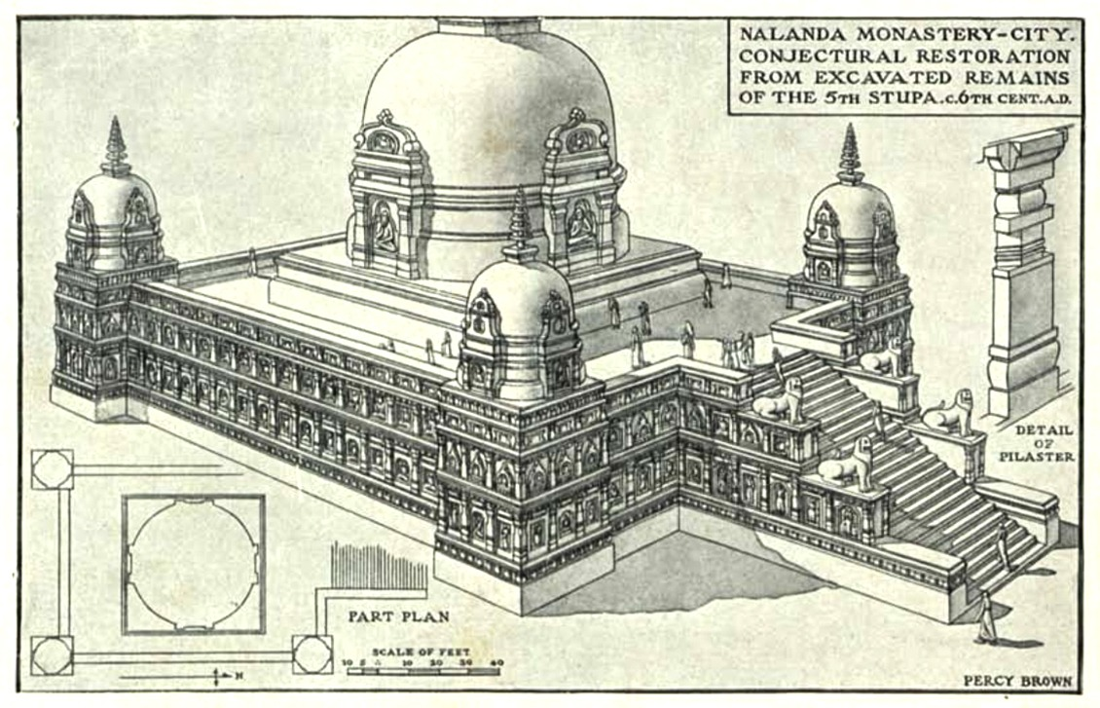
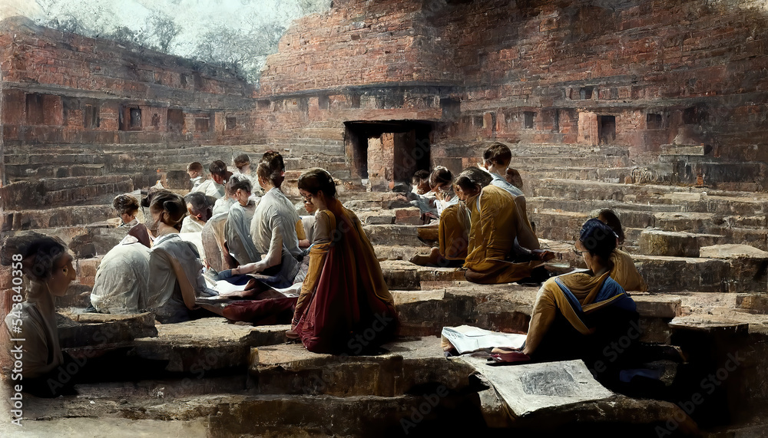
Structure and Design
Nalanda University
STRUCTURE
&
DESIGN
CAMPUS LAYOUT
It featured monasteries, stupas, temples, lecture halls, libraries, and lush gardens, reflecting a vast, scholarly layout.
1
STUDENT & STUDY LIFE
WHAT WAS STUDIED AND TAUGHT
Scholars from diverse regions studying philosophy, medicine, and arts. Students engaged in debates, meditation, and discussions, fostering a rich cultural and academic environment.
2
SUBJECTS TAUGHT
Curriculum
Vedas were taught, they also trained in fine arts, medicine, mathematics, astronomy, politics and the art of warfare.
3

Slide 5
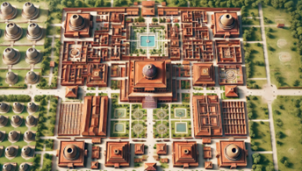
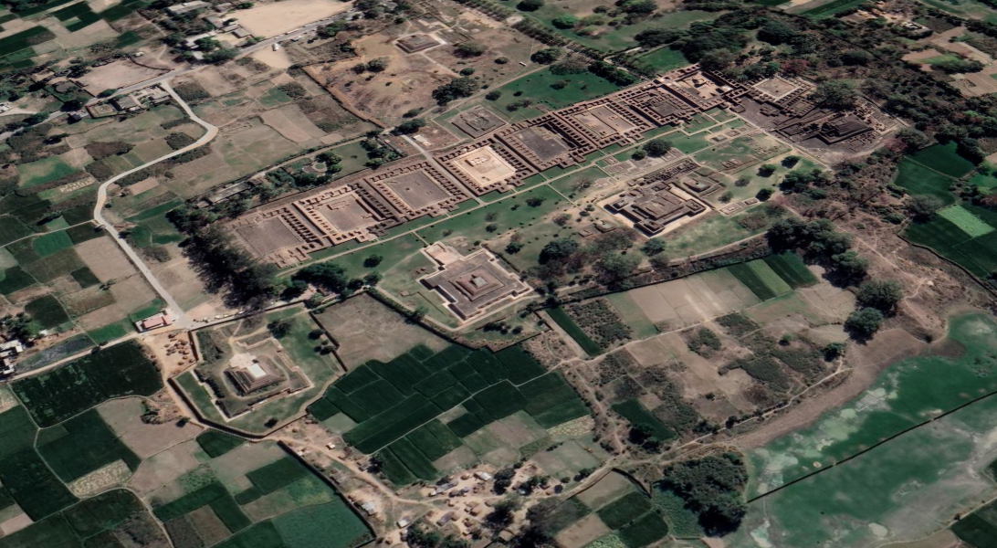
Structure and Design
Nalanda University
CAMPUS LAYOUT – Water Features
There were well-designed water bodies, tanks, and canals within the campus that contributed to its aesthetic and functional layout.
4
Water Features
Multistoried Libraries
LIBRARIES
It housed an extensive library system known as Dharmaganja, consisting of 3 large buildings, including Ratnasagara, Ratnadadhi, and Ratnaranjaka.
5
Picture of Nalanda University as imagined
by Artificial Intelligence
Satellite View of Nalanda University Ruins

Slide 6
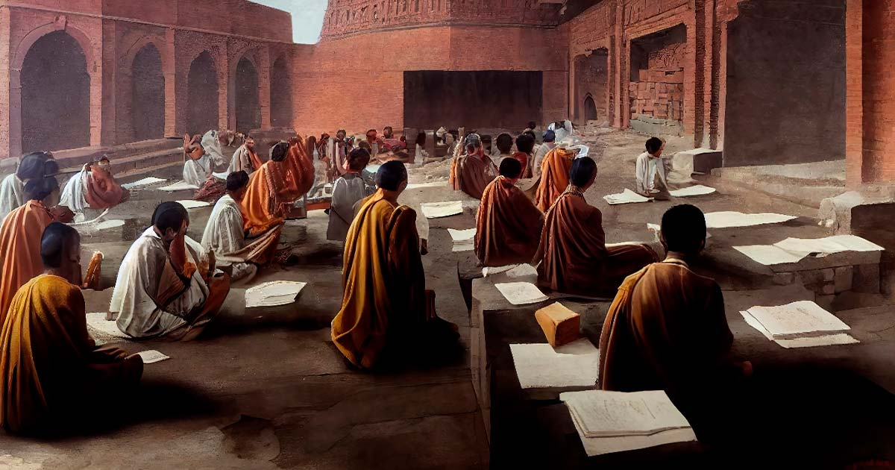
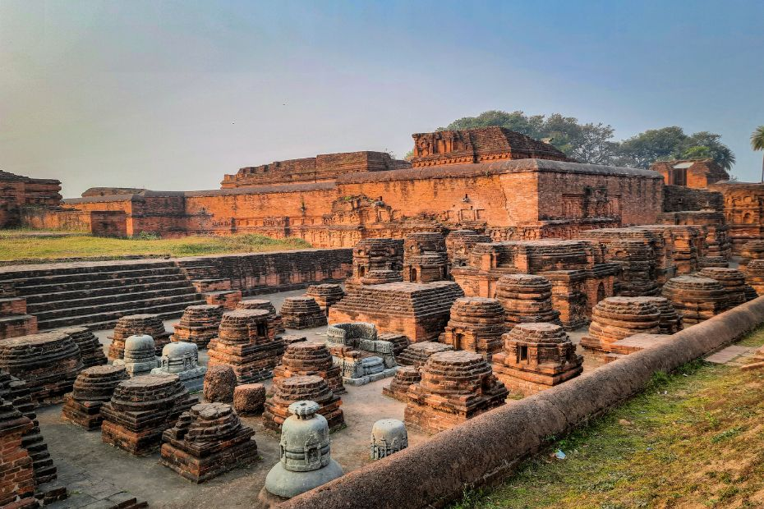
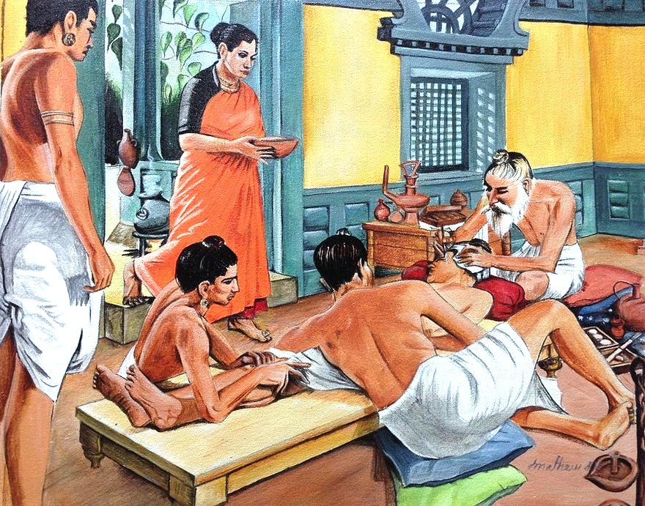



SIGNIFICANCE OF NALANDA UNIVERSITY
02
CENTRE OF
MULTIPLE
DISCIPLINES
03
PHILOSOPHIC STUDIES, AYURVEDIC AND MEDICAL SCIENCES
01
SELECTIVE
ADMISSION
PROCESS

Slide 7


SIGNIFICANCE OF NALANDA UNIVERSITY
05
BUDDHIST KNOWLEDGE TO TIBET
04
ALL
ACROSS THE WORLD

Slide 8
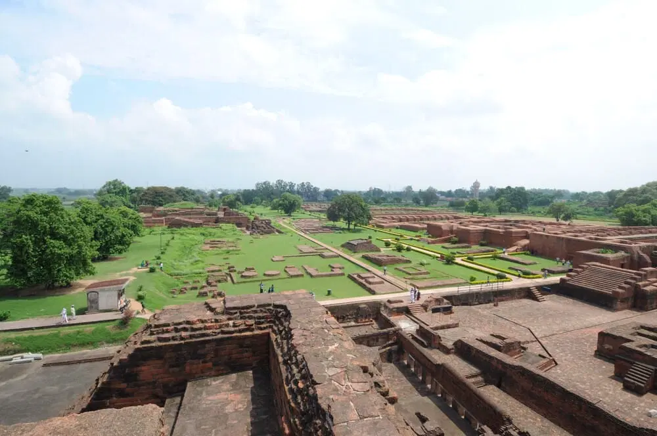
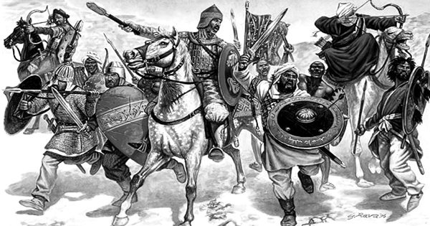
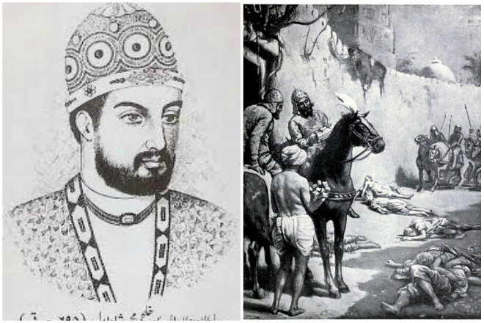
DECLINE OF NALANDA UNIVERSITY
1.Start Of Decline
2. FINAL ATTACK
3. TABAQAT-I-NASIRI
Archeological surveys found proof that Nalanda university was attacked many times.There were total Three attacks on Nalanda. First destruction was by the Huns under the reign of Mihirakula, second one was by The Goudas in the 7th century.
Nalanda University was destroyed in 1193 by Bakhtiyar Khilj.Leading an army under the Delhi Sultanate, Khilji attacked the renowned university, burning its libraries and massacring scholars.
This destruction marked the decline of Nalanda as a center of learning. Minhaj-i-Siraj, a historian of that era, chronicled these events in his work Tabaqat-i Nasiri

Slide 9

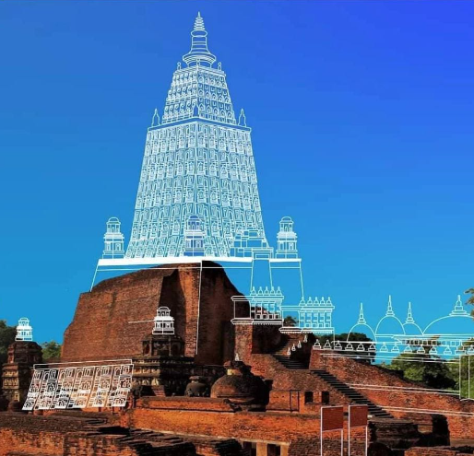

Slide 10

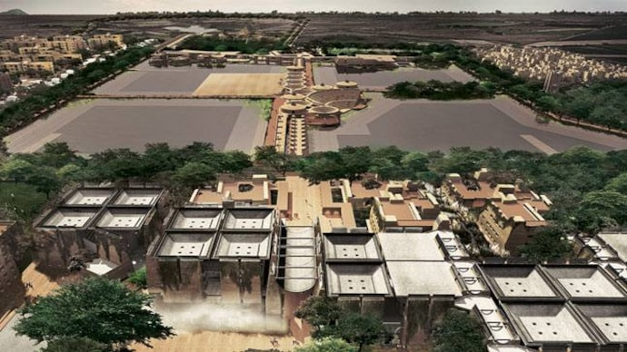
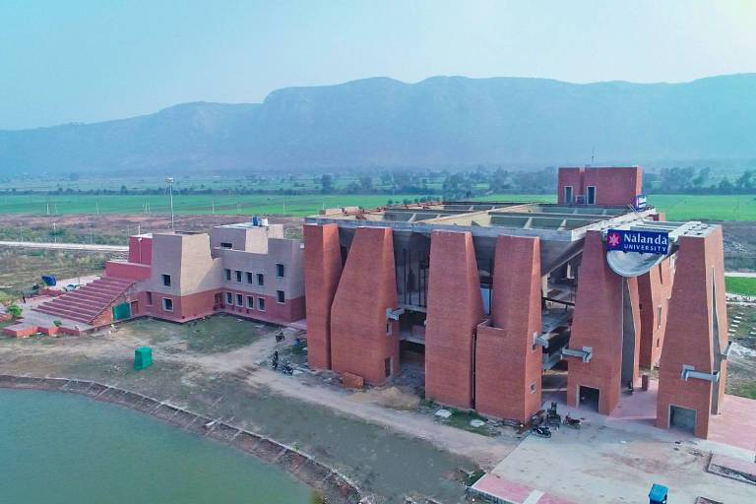
MODERN REVIVAL OF NALANDA UNIVERSITY
ESTABLISHMENT OF NALANDA UNIVERSITY (2006)
01
The Indian government established a new Nalanda University in Bihar, reviving the ancient institution's legacy as a global center of learning.
NALANDA UNIVERSITY ACT 2010
The Act aims to revive the ancient Nalanda University as a center for learning, research, and teaching in various disciplines, drawing inspiration from its historical significance.
02
UN HERITAGE SITE
03
Nalanda was designated a UNESCO World Heritage Site in 2016, recognizing its historical significance and contributions to education and culture

Slide 11



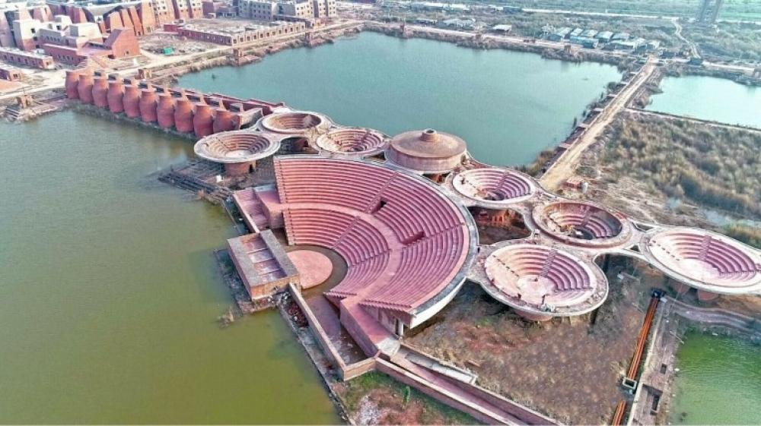
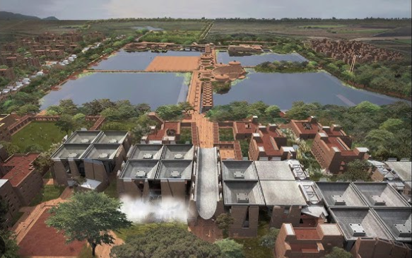
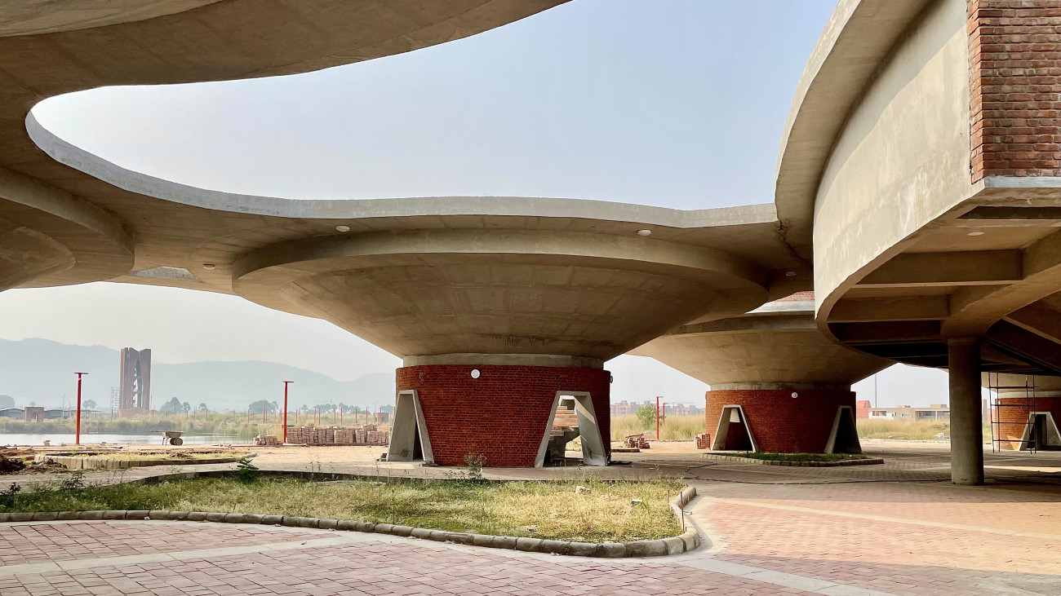
NALANDA UNIVERSITY: A TIMELESS BEACON OF KNOWLEDGE
A LEGACY REBORN
GLOBAL INFLUENCE
CONTINUING THE JOURNEY
Nalanda’s ancient wisdom lives on, inspiring modern education
The reivival of Nalanda is a commitment to innovation,learning and cultural exchange globally.
From the past to present, it has shaped global academic thoought

Slide 12
BIBILIOGRAPHY
https://whc.unesco.org/en/list/1502/
https://www.reddit.com/r/bihar/comments/17l9d4r/nalanda_universityy
https://www.reddit.com/r/bihar/comments/kyduqr/artists_depiction_of_what_nalanda_university/?utm_source=share&utm_medium=web3x&utm_name=web3xcss&utm_term=1&utm_content=share_button
https://www.reddit.com/r/IndiaSpeaks/comments/jwxxhp/ruins_of_nalanda_university_in_bihar/?utm_source=share&utm_medium=web3x&utm_name=web3xcss&utm_term=1&utm_content=share_button
https://www.reddit.com/r/bihar/comments/kyduqr/artists_depiction_of_what_nalanda_university/?utm_source=share&utm_medium=web3x&utm_name=web3xcss&utm_term=1&utm_content=share_button
https://en.wikipedia.org/wiki/Nalanda_University

Slide 13

THANK YOU
Group Leader – Vraj Ved
Members – Abhishek Upadhyay, Anjali Sinha, Darshan Ved, Naina
Presentation – Darshan Ved, Naina, Vraj Ved
Information and Research – Abhishek Upadhyay, Anjali Sinha
Pictures – Abhishek Upadhyay, Anjali Sinha, Vraj Ved
Animations – Darshan Ved, Vraj Ved
Design – Anjali Sinha, Darshan Ved, Naina
Write Up - Naina
Thank You audience for listening to us
Thanks to all my group members who gave their best in the making of this project

